Slide 1

Analysis on Us Craft Beer
Authors: William Arnost and Meisam A. Mansor
Audience: Carlos Brito, CEO of Anheuser-Busch InBev
Address of Study: https://github.com/warnost/CaseStudy01

Slide 2
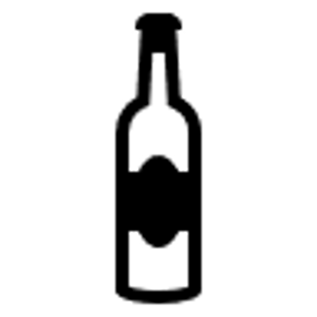

We analyzed two data sets
Beer DataSet
Info on 2410 US Craft Beers
Brewery DataSet
Geographic data for 558 Breweries
Name
Style
Alcohol Content (ABV)
Bitterness (IBU)
Serving Size (Oz)
Brewery ID
Name
City
State
Brewery ID

Slide 3
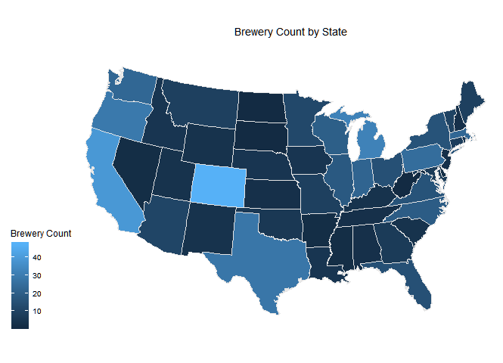
Brewery Count by State
Brewery Count by State
1. Colorado (47)
2. California (39)
3. Michigan (32)
4. Oregon (29)
5. Texas (28)
Brewery Count
* Alaska and Hawaii are omitted

Slide 4
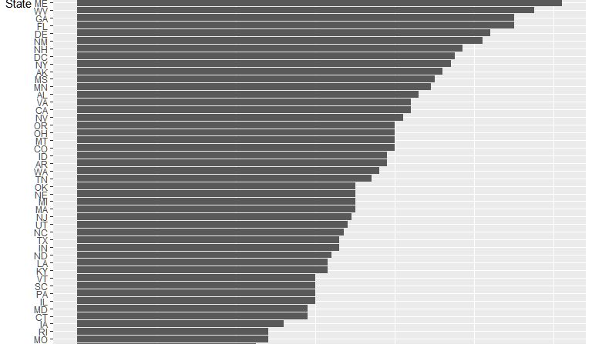
most Bitter Beer?!
IBU Index
‘Maine’ &
‘West Virginia’
have the highest median bitterness (IBU) greater than 130.

Slide 5
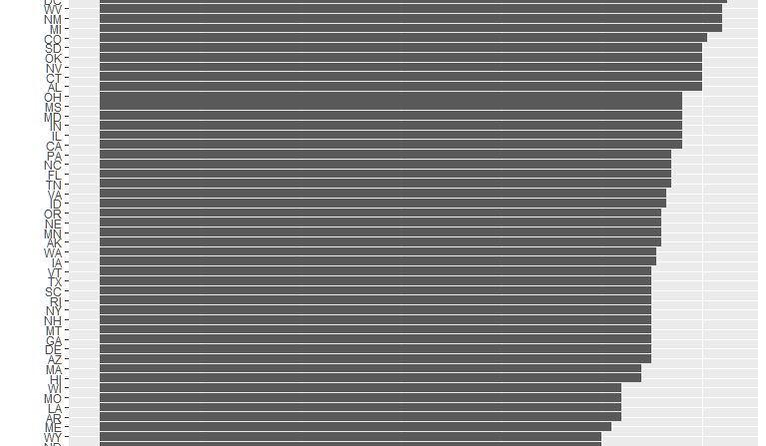
the most Alcoholic Beer?!
ABV Index
Kentucky&
DC
produce the beers with the highest median alchohol by volume with greater than 12%

Slide 6
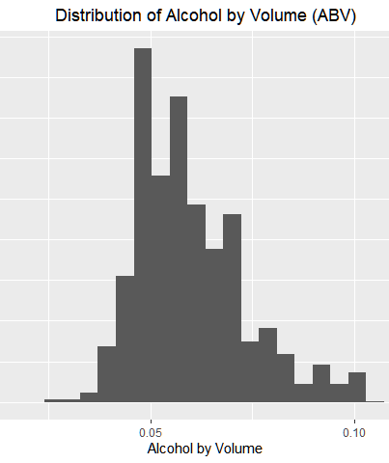
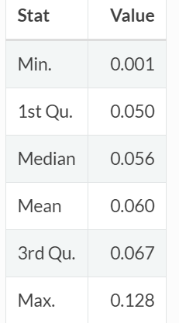
How much Alcohol is in US craft beer?
Most Beers have alcohol content between 5% - 6.7%.
It is rare for beer to exceed 10% ABV.

Slide 7
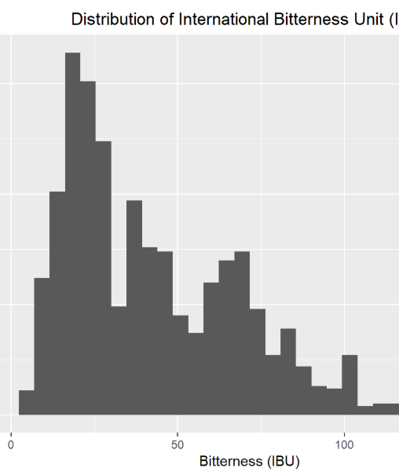
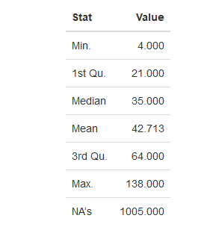
IBU index
Most IBU content are between
21-64
It is rare IBU be greater than 100.

Slide 8
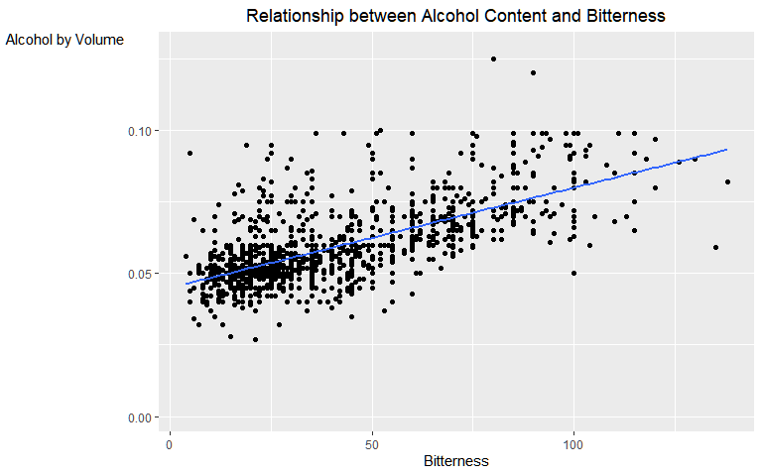
How are Alcohol Content and Bitterness Related?
Alcohol by Volume
There is evidence that there is a relationship between Alcohol Content and Bitterness.
Bud Light, InBev’s most popular beer, has an
ABV= 4.2% and IBU=6
Bitterness

Slide 9
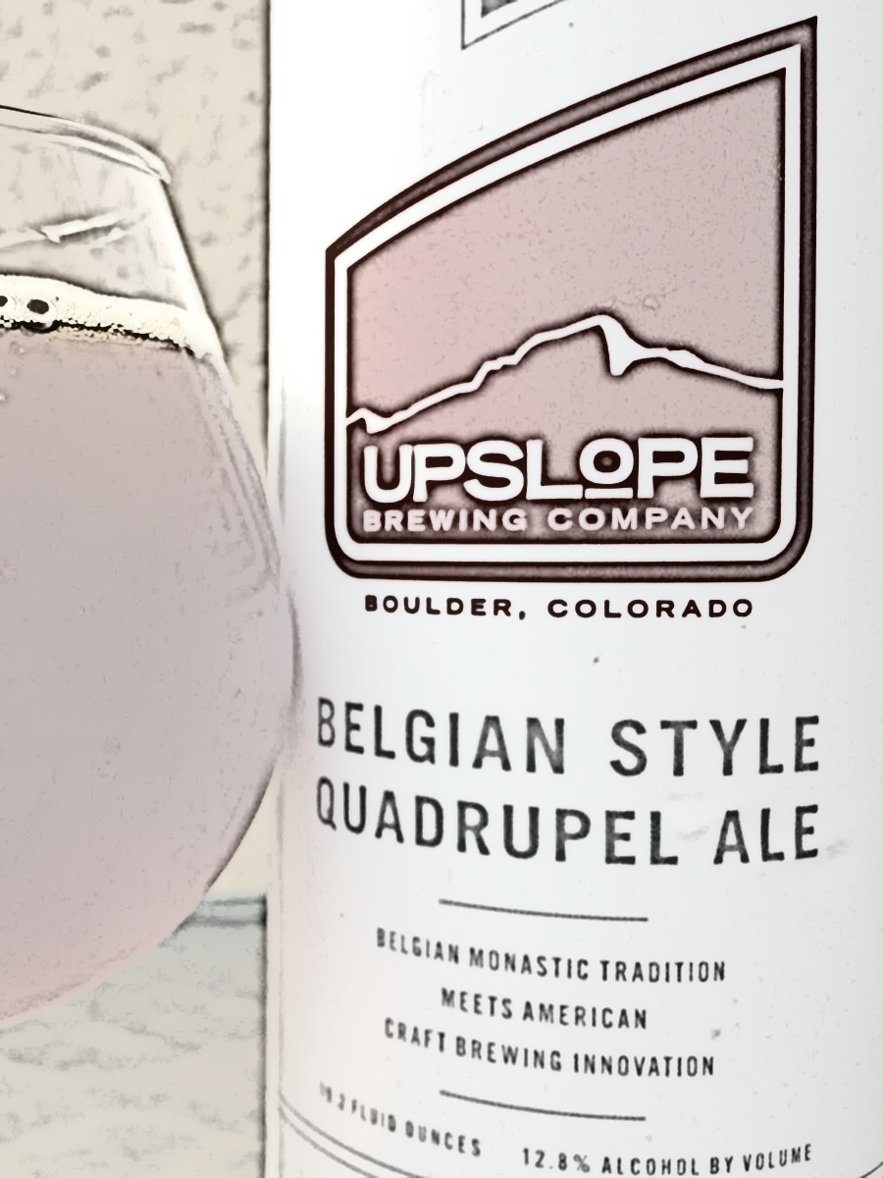
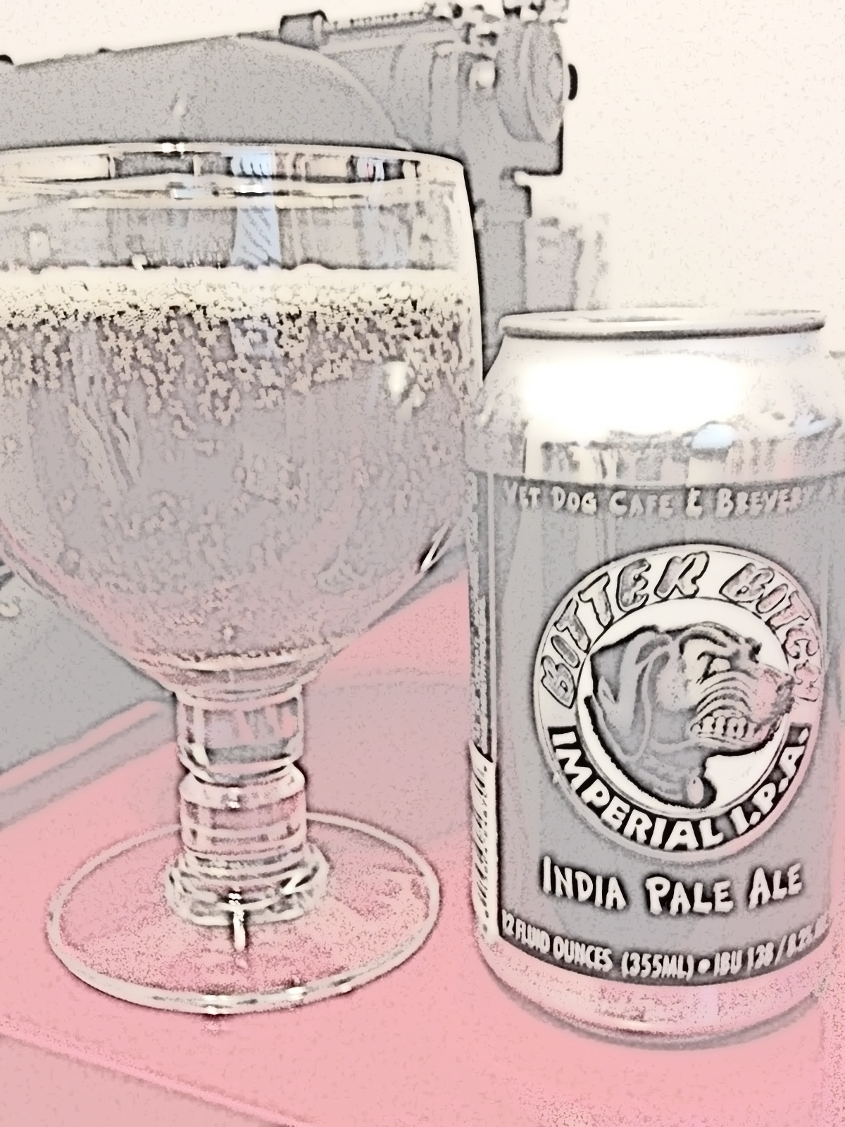
Most Interesting Beers
Most Alcohol
Most Bitter
Name:
Lee Hill Series Vol. 5
Alcohol Content:
12.8%
State: Colorado
Brewery: Upslope Brewing
Style: Quadrupel (Quad)
Size: 19.2 oz
Name:
Bitter Bitch
Bitterness:
138 IBU
State: Oregon
Brewery: Astoria Brewing Company
Style: American Double / Imperial IPA
Size: 12 oz

Slide 10
Conclusions
Colorado and California have the most craft breweries.
Lee Hill Series Vol.5 is the most alcoholic craft beer (12.8%).
Bitter Bitch is the most bitter beer (138 IBU).
Craft Beers tend to have alcohol content between 5% and 6.7%.
Craft Beers tend to have IBU content between 21-64.
There is a positive relationship between alcohol content and bitterness in craft beers.

